Slide 1
Project Presentation
Seminar Computational Social Science

Slide 2

Agenda
introduction of our team
short presentation of our idea / design
time to discuss our questions

Slide 3
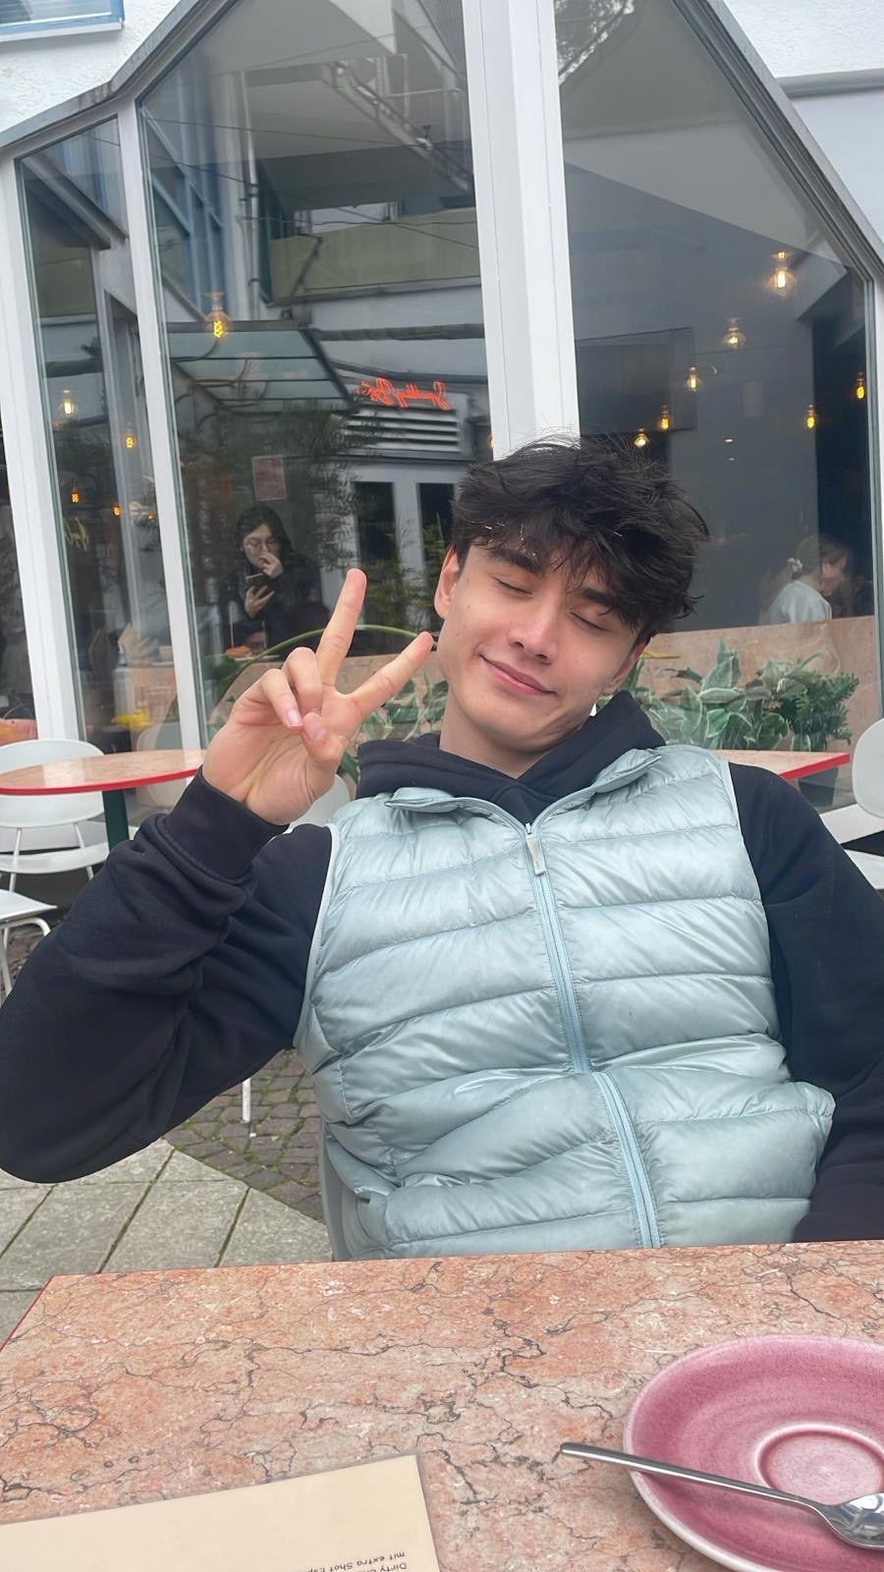
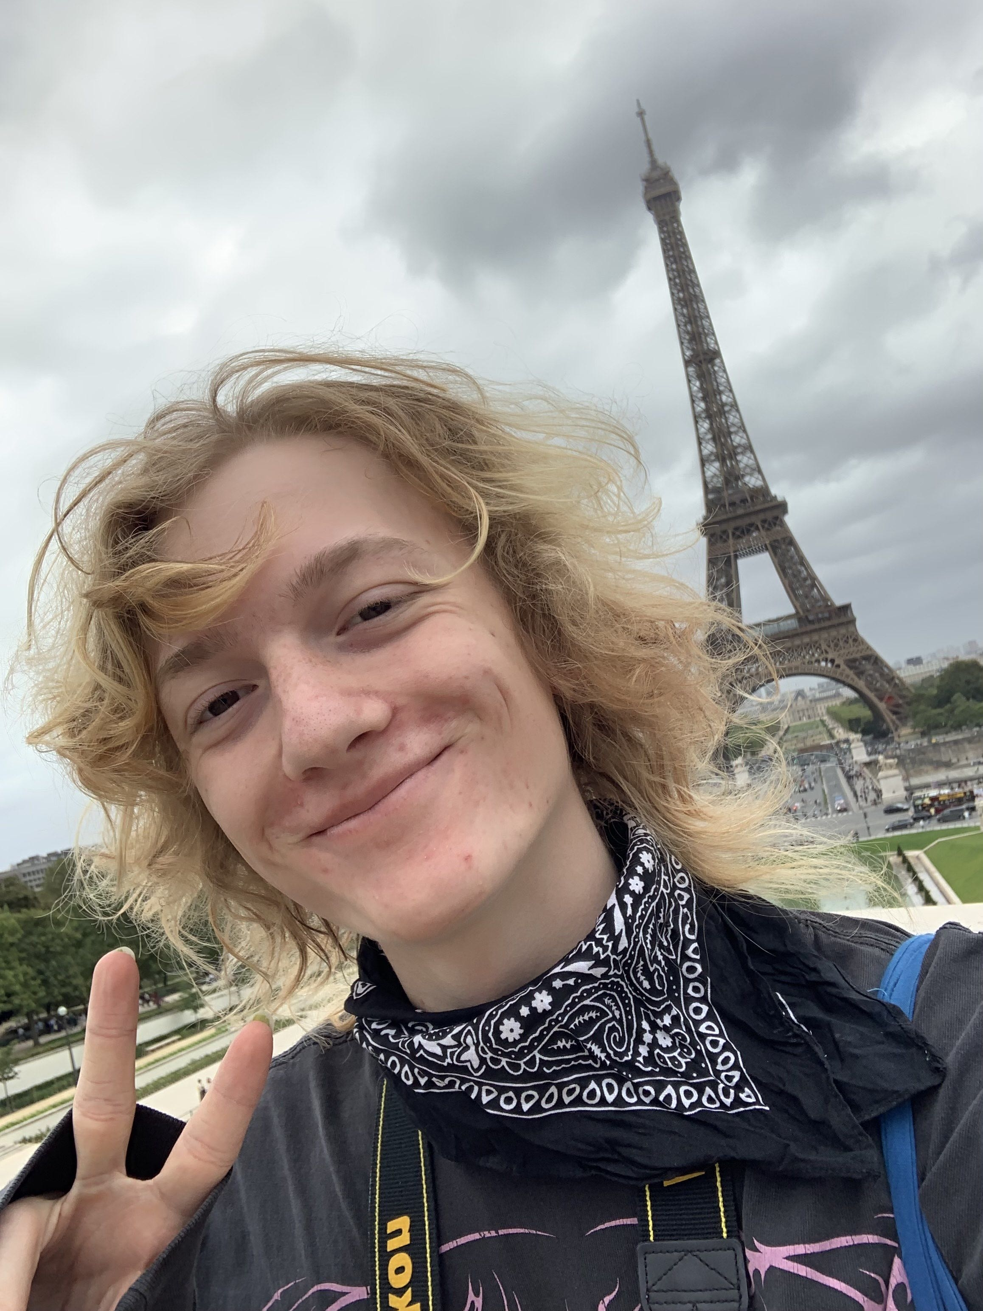
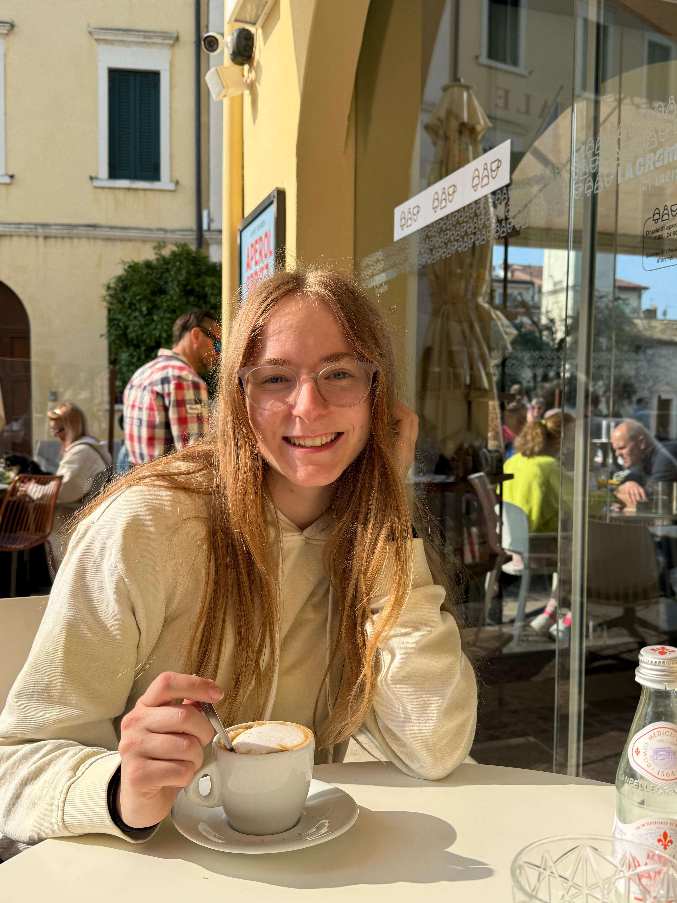
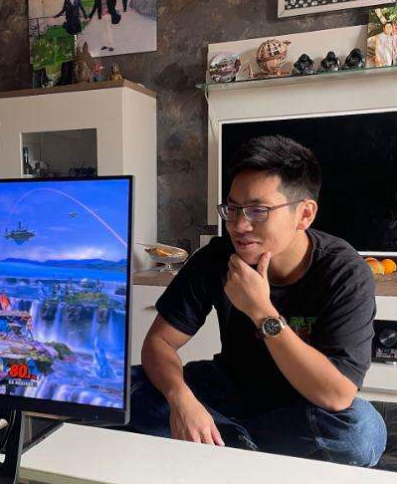
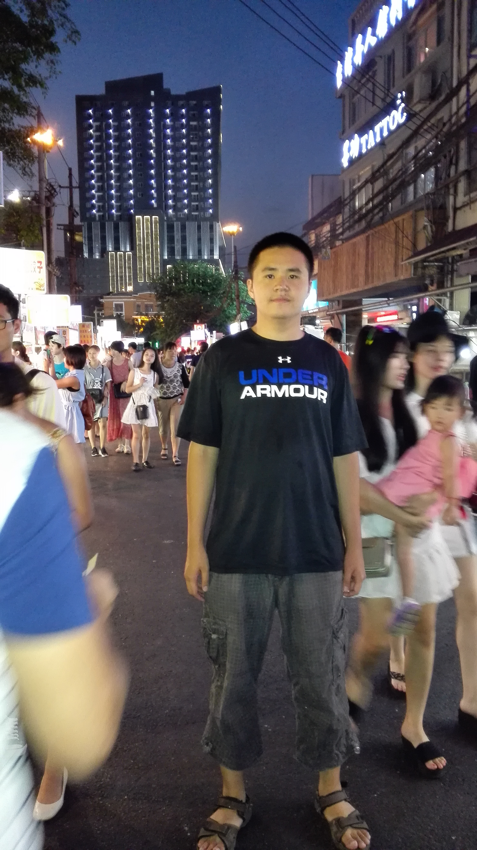
Introduction of us :)
We‘re a team of
2x Information Systems Bachelor students
3x Computer Science Bachelor students
Luca
Marlon
Sophie
Thommy
Yan

Slide 4
The Problem

Slide 5
The idea
make it easier for elderly people to find help regarding digital questions
app/website for service requests
different view/layout for requesting and helping side
chatting option

Slide 6
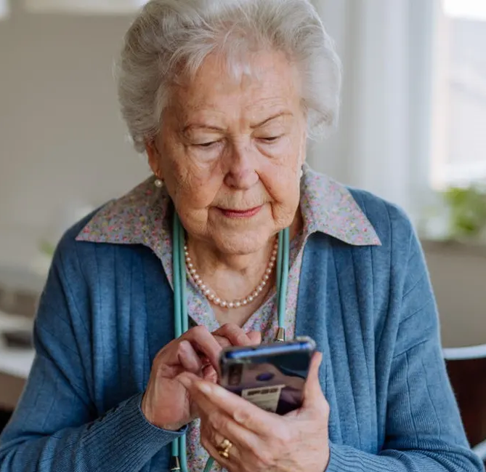
UI for requests
intuitive design
larger font size
less buttons
easy layout
focus on simplicity
ANFRAGEN
NEUE ANFRAGE
Anfrage 1
Beschreiben Sie hier Ihr Problem
Anfrage 2
Anfrage 3
NEUE ANFRAGE
ANFRAGE SENDEN

Slide 7
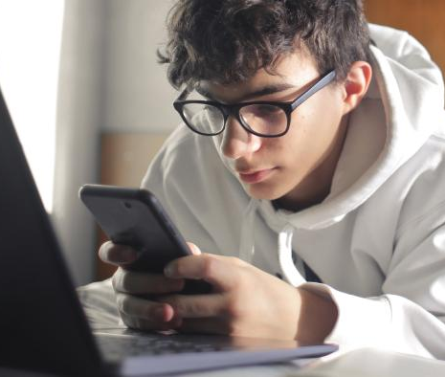






UI for helping
overview of requests with filter options
more details
user profile
point system as incentive (scoreboard)
Suche...
Filter...
Anfrage 1
Anfrage 2
Anfrage 3

Slide 8
Our Roadmap

Slide 9
time for questions :)

